Slide 1
Integrate clients into the network and network documentation
Lernfeld 3
07.01.2020

Slide 2
Content
Network documentation and planing
The new user and the server
Leasing or Buy
Bernt Vogt has wrong permission
Automatisation

Slide 3
Network documentation and planing

Slide 4
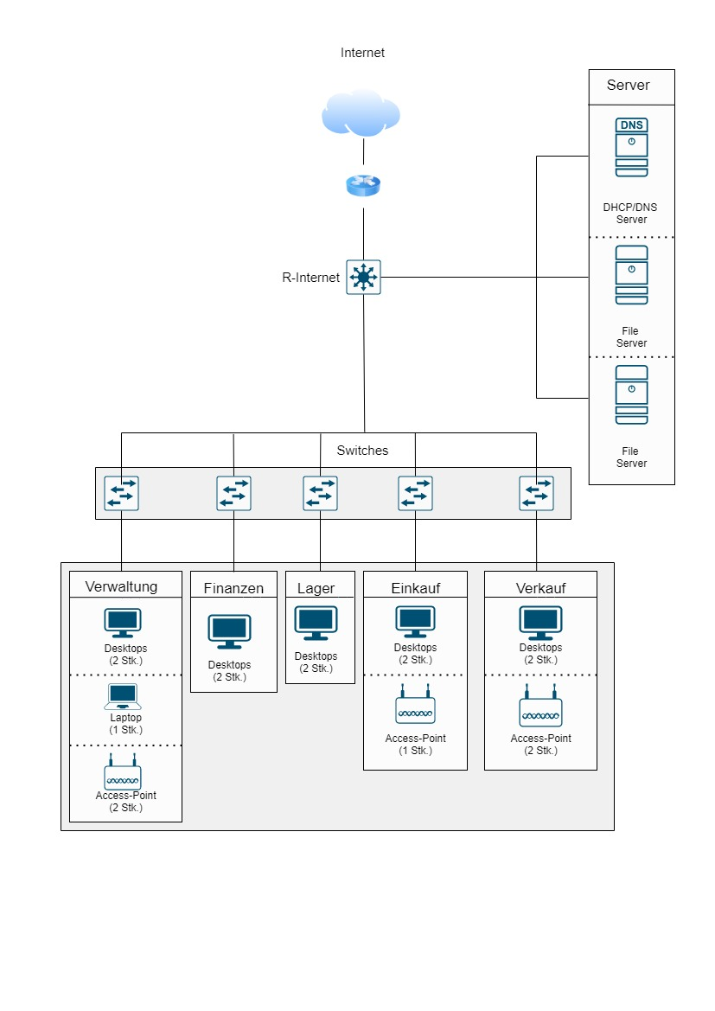
Current-Standing
The network at the begning

Slide 5
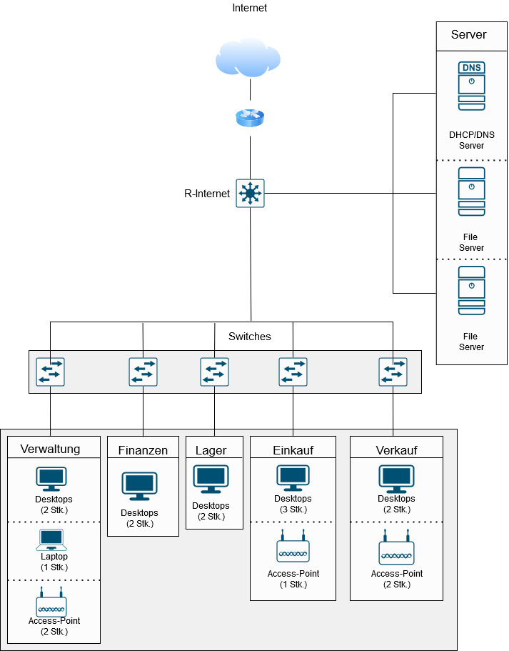
Future-Standing
The network at the end

Slide 6
Network documentation
All about the network and the planing
you will find in our network documenation

Slide 7
The new user and the server

Slide 8
Leasing or Buy

Slide 9
What is Leasing?
A Lease is a contract specifying the terms under which the owner of some property transfers the right to use the property to someone else, without transferring legal ownership.

Slide 10
Advantages of Leasing
No down payment
Avoid risks of ownership
Once you no longer need it, you can end the agreement
Flexibility
Simplicity
Disadvantages of Leasing
Additional insurance coverage is necessary
Potential for extra fees
The need to get the new devices at end of the term

Slide 11
Advantages of loan
Cheaper
It belongs to you
You can break for a while
Disadvantages of loan
Outdate devices
You have to pay the reparation
The fees will increase

Slide 12
Jahre | Leasingrate in € | Restwert Nach 4 Jahre | Gesamte Leasingkosten in €
1 | 72.000 | 304.000 | 232.000
2 | 72.000 | 232.000 | 160.000
3 | 72.000 | 160.000 | 88.000
4 | 72.000 + 16000 | 88.000 | 0
Gesamt | 304.000
Leasing
Jahre | Schuld Anfang d.j.in € | Zinsen 5%, p.a.in € | Tilgung Ende d.j.in € | Kreditrate in € | Restschuld Ende d. j. in e
1 | 240.000 | 12.000 | 60.000 | 72.000 | 180.000
2 | 180.000 | 9000 | 60.000 | 69.000 | 120.000
3 | 120.000 | 6000 | 60.000 | 66.000 | 60.000
4 | 60.000 | 3000 | 60.000 | 63.000 | 0
Gesamt |  | 30.000 | 240000 | 270000
Loan

Slide 13
Bernt Vogt has wrong permission

Slide 14
Automatisation

Slide 15
Rawezh Hama
Andy Gahler
Emile Essam
Joshua Sadowsky

Slide 16
We are very pleased when answere your question ☺

